Slide 1
Implementing Enterprise DevOps in a large organisation – Sasol Story
Bramley Maetsa Delivery Enablement Senior Manager, Sasol

Slide 2
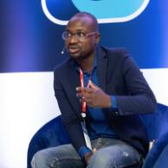
About:
I look after DevSecOps and Chapters at Sasol IM
Background in Engineering, Software development, Pre-sales and IT consulting
Passionate about Education, mentorship, and anything disruptive
Amateur golfer
Bramley Thomas Maetsa
Delivery Enablement – Snr Manager

Slide 3
What’s in the agenda
Solid business case
What was our case for change
Sasol IM vision
What was IM vision and ambition
Vision
1
Technology Lens
What technology we invested in
Technology
People Lens
4
Digital
Transformation
2
People Lens
How did we organize ourselves for success
Process Lens
3
Process Lens
What was our operating model for success

Slide 4
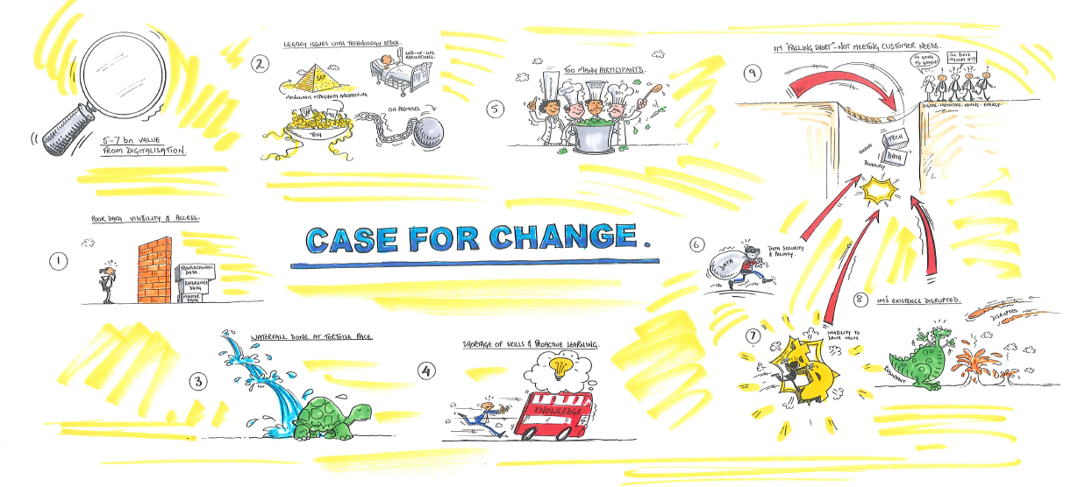
What you find in most large organisations
1

Slide 5
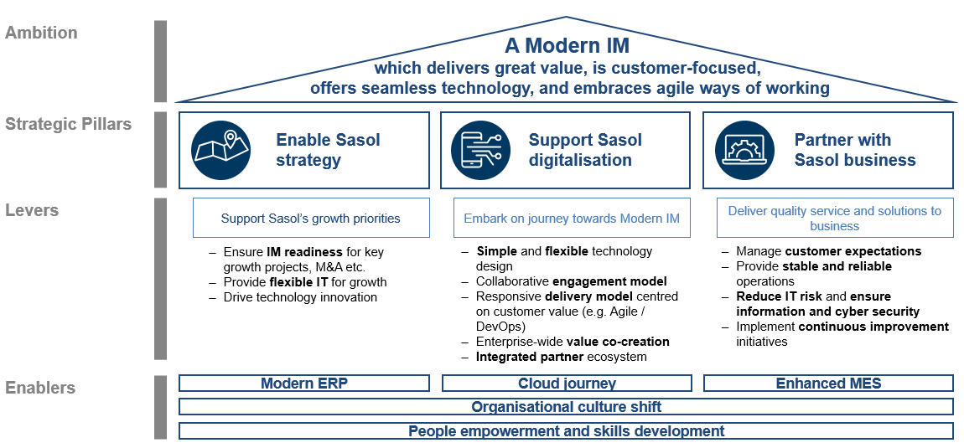
Vision
1

Slide 6


People Lens: Team Org Chart
2
Corporate
energy
chemical
CIO
Responsible for strategy and roadmap
Standards, policies, templates and frameworks
Create a digital backbone for business to be able to digitalise
Delivery
Portfolios
Platforms
DevOps
Delivery
Portfolios
Platforms
DevOps

Slide 7
People Lens: Team Org Chart
2
Team 1
Team 2
Team 3
CHAPTER
A number of Chapters have been identified
Chapters are a way to promote experience sharing, best practice, collaboration, cross pollination of ideas, and innovation across Agile teams
Development
Operations
Solution Architecture
Quality Engineering
TEAM CATALYST
TEAM CATALYST
TEAM CATALYST
Technical chapters
BUSINESS
BUSINESS
BUSINESS
Business chapters
A “Chapter” comprise team members from different sprint teams at a global level that work in a common area / on a common topic
A Chapter will meet on a regular basis to exchange ideas and seek input from colleagues on a specific issue / challenge taking place in their respective sprint
A Chapter will incubate new ways of working and thinking in order to embed these in the new organization
The focus of a Chapter is to enable rather than to govern. The enforcement of standards must be automated to enable a way-of-work rather than becoming a check-box exercise
Each chapter has Community of Practices (COP), a forum that aims to drive adoption, knowledge sharing and maturity of chapters
CORE
CORE
CORE
User Experience
Design
Business Analysis
Data &
Analytics
Project Delivery
Chapter leads are ultimately responsible for building and managing a world-class global Chapter capability that is enabling and where standards are enforced through automation across all delivery teams
Responsibilities include:
Owns the Chapter Playbook: Defining the Methods, Patterns, Standards, Tools, Processes and Controls for the discipline
Automates the enforcement of standards so that it becomes a way of work
People training & New Ways of Working evangelism
Bringing together the community of the Chapter
Identify skills required and skills gaps
SUPPORT
SUPPORT
SUPPORT

Slide 8

Process Lens: DevOps
3
DevOps
DevOps is the union of people, process, and products to enable continuous delivery of value to our end users

Slide 9
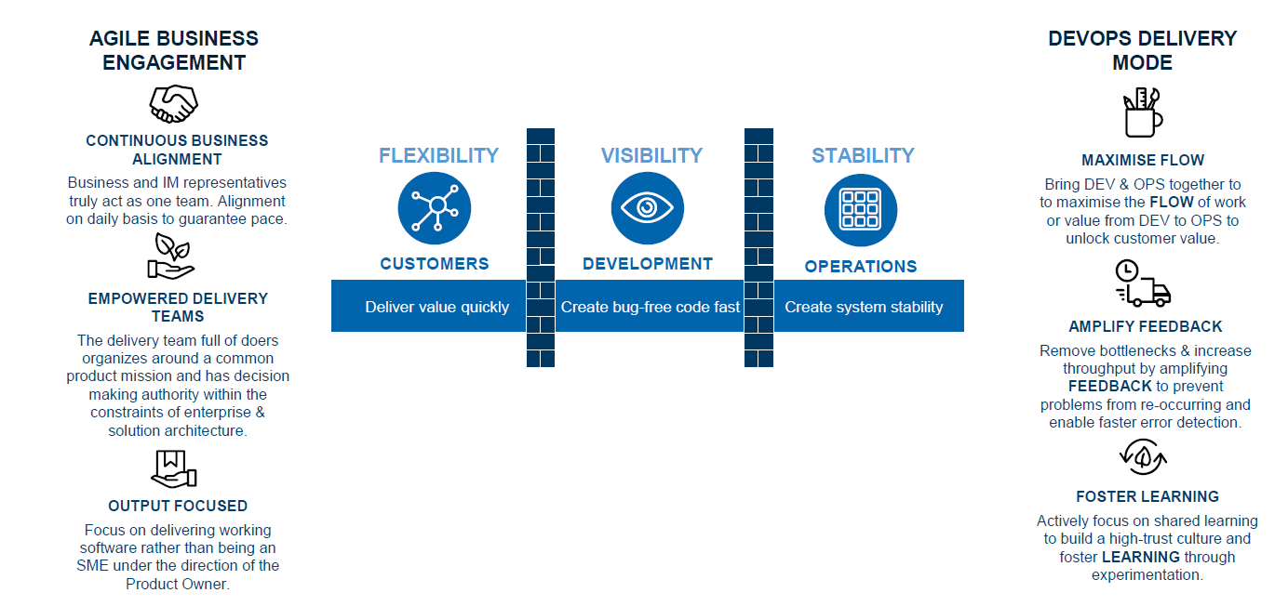
Process Lens: DevOps
3

Slide 10
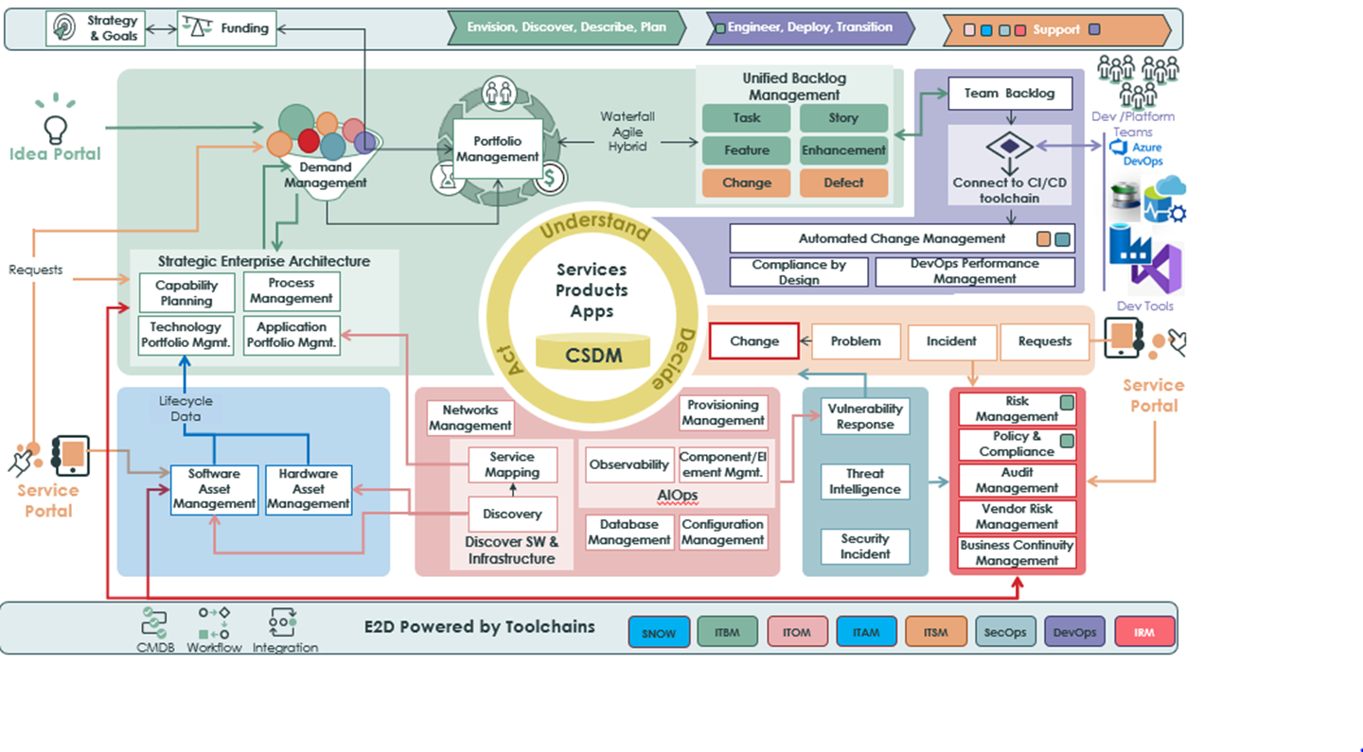
Technology Lens: E2D
4

Slide 11
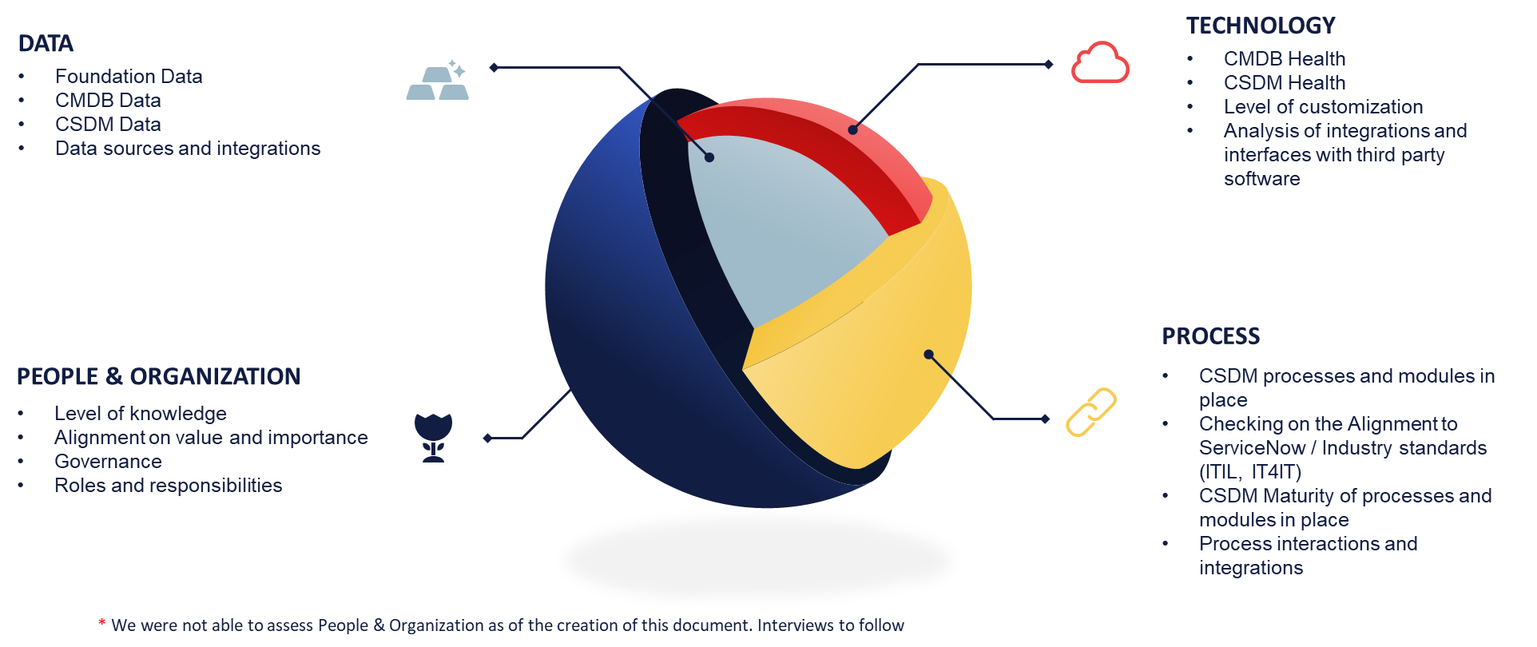
Technology Lens: Set the foundation
4

Slide 12
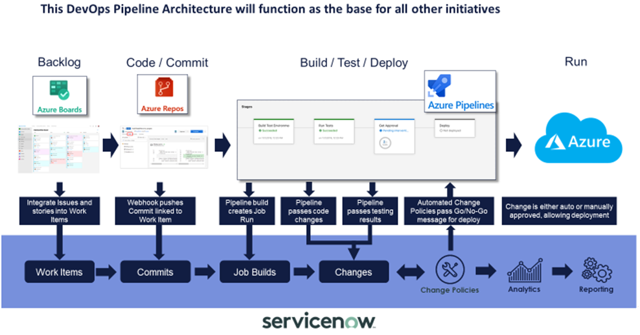
Technology Lens: Focus on integration
4
Implement & Scale ServiceNow DevOps to integrate CI/CD with Change Management and provide Cross-organisational insights to teams and Senior Management

Slide 13
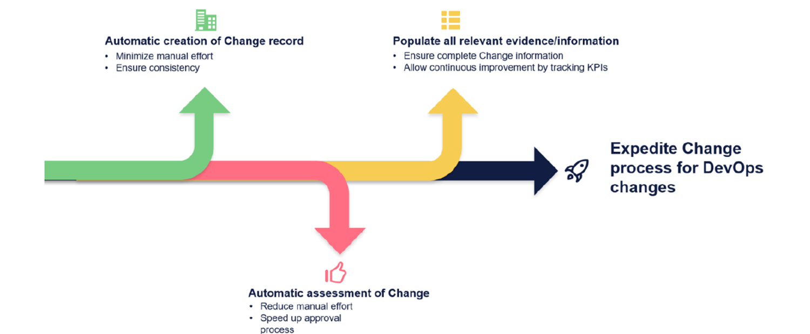
Technology Lens: Automated changes
4

Slide 14
Technology Lens: Automated changes
4

Slide 15
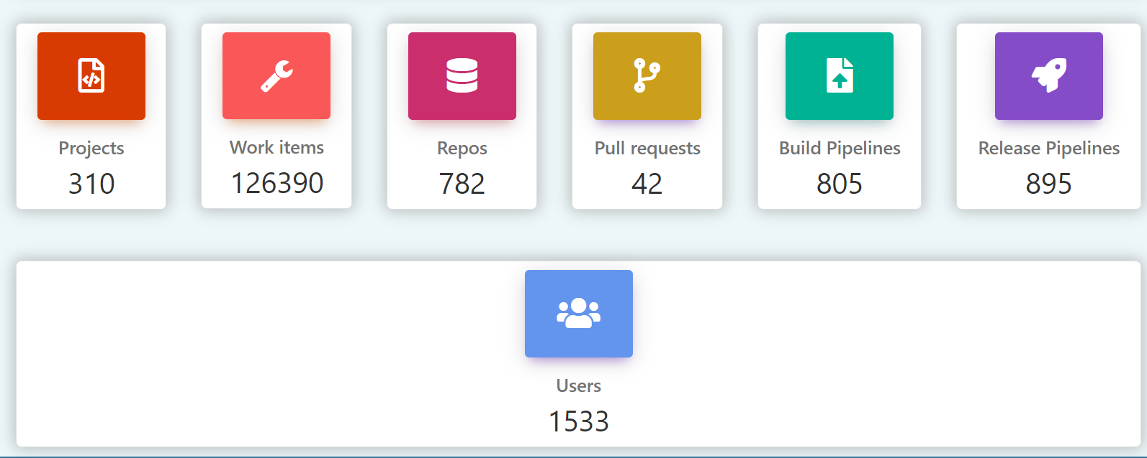
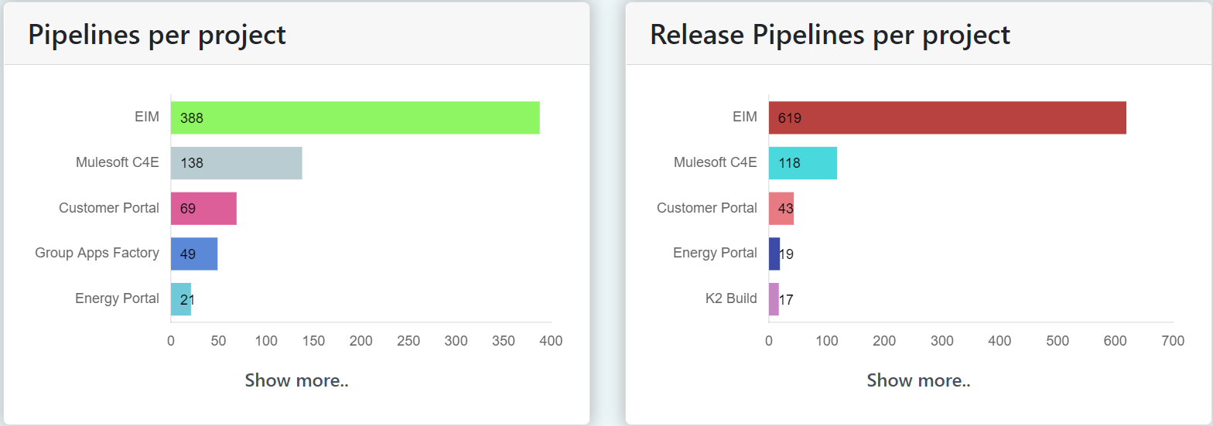
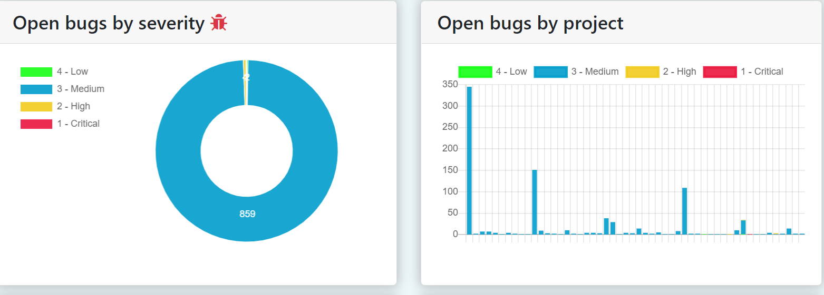
Performance metrics Lens: Measure what we do
5

Slide 16
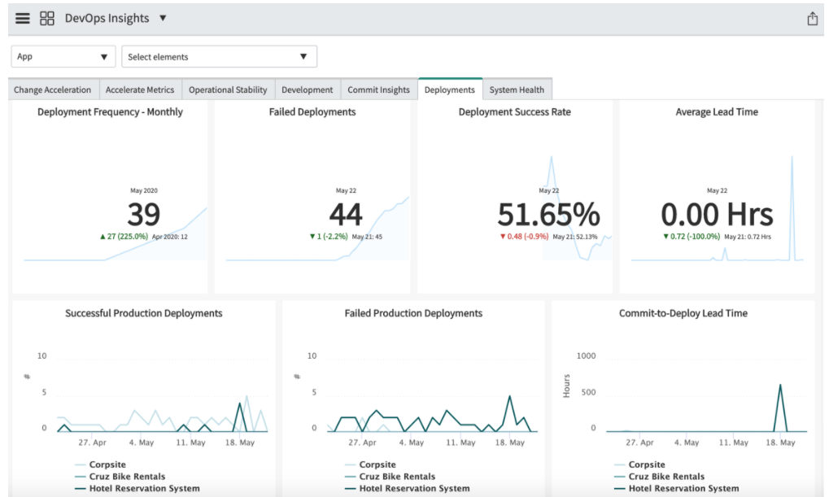
Performance metrics Lens: Measure what we do
5

Slide 17
Key Takeaway / Recommendations
You need the Vision, Org (people), Investment (VOI)
Vision: IT strategy must align with the with business, be bold and clear with the vision
Org: You need the structure that supports your ambition
Investment: Invest in modern technology
Find out more at the ServiceNow booth or visit: servicenow.com/devops

